Slide 1
PRESENTATION CASE STUDY on any natural disaster
SUBMITTED BY :
ANHAD ARSHNOOR SINGH
CRN : 2221144
URN : 2303077

Slide 2
Indian Ocean Tsunami (2004)
The Indian Ocean Tsunami, one of the deadliest natural disasters in history, had a profound impact on the affected countries and led to significant changes in disaster preparedness.

Slide 3
The most powerful earthquake in the 21st century, and at least the third most powerful earthquake ever recorded in the world since modern seismography began in 1900. It had the longest duration of faulting ever observed, between eight and ten minutes. It caused the planet to vibrate as much as 10 mm (0.4 in), and also remotely triggered earthquakes as far away as Alaska. Its epicentre was between Simeulue and mainland Sumatra. The plight of the affected people and countries prompted a worldwide humanitarian response, with donations totaling more than US$14 billion

Slide 4
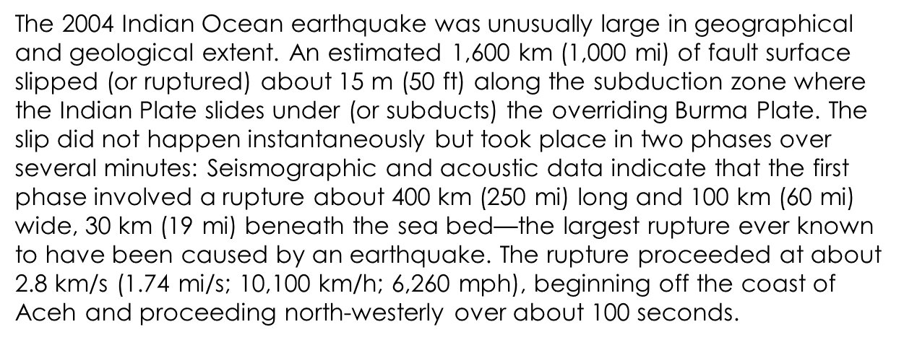
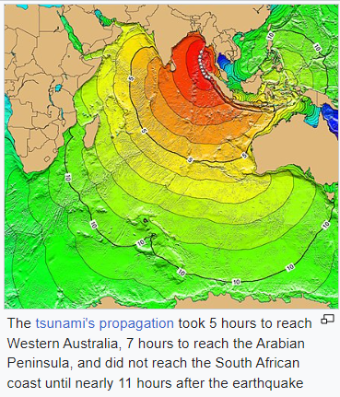

Slide 5
CAUSES
The earthquake was caused by the subduction of the Indian Plate beneath the Burma Plate. The sudden shift in tectonic plates generated massive tsunami waves that radiated across the Indian Ocean.
On December 26, 2004, at 7:59 AM local time, an undersea earthquake with a magnitude of 9.1 struck off the coast of the Indonesian island of Sumatra. Over the next seven hours, a tsunami a series of immense ocean waves triggered by the quake reached out across the Indian Ocean, devastating coastal areas as far away as East Africa. Some locations reported that the waves had reached a height of 30 feet (9 metres) or more when they hit the shoreline.

Slide 6
EFFECTS
The tsunami caused one of the largest natural disasters in recorded history, killing at least 225,000 people across a dozen countries, with Indonesia, Sri Lanka, India, Maldives, and Thailand sustaining massive damage. Indonesian officials estimated that the death toll there alone ultimately exceeded 200,000, particularly in northern Sumatra’s Aceh province. Tens of thousands were reported dead or missing in Sri Lanka and India, a large number of them from the Indian Andaman and Nicobar Islands territory.

Slide 7
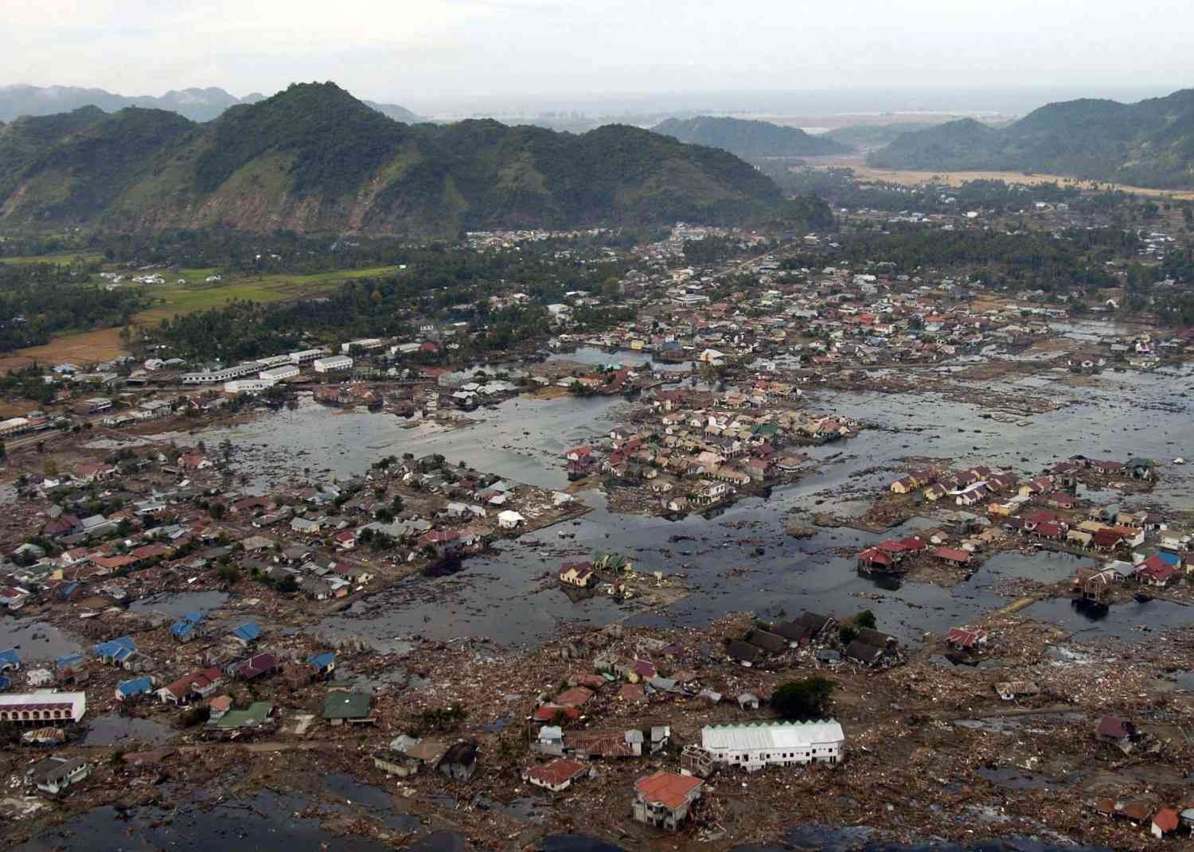
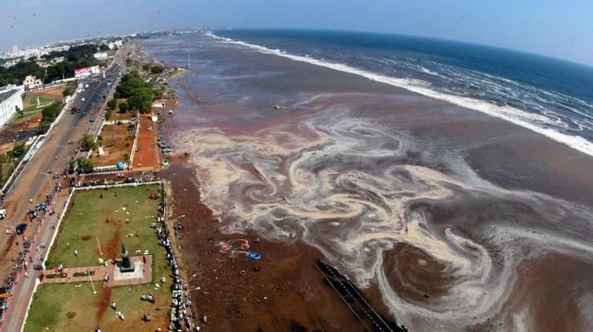
The tsunami left both the people and government of India in a state of heightened alert. On 30 December 2004, four days after the tsunami, Terra Research notified the India government that its sensors indicated there was a possibility of 7.9 to 8.1 magnitude tectonic shift in the next 12 hours between Sumatra and New Zealand. In response, the Indian Minister of Home Affairs announced that a fresh onslaught of deadly tsunami was likely along the southern Indian coast and the Andaman and Nicobar Islands, even as there was no sign of turbulence in the region. The announcement generated panic in the Indian Ocean region and caused thousands to flee their homes, which resulted in jammed roads. The announcement was a false alarm, and the Home Affairs minister withdrew their announcement. On further investigation, the India government learned that the consulting company Terra Research was run from the home of a self-described earthquake forecaster who had no telephone listing and maintained a website where he sold copies of his detection system

Slide 8
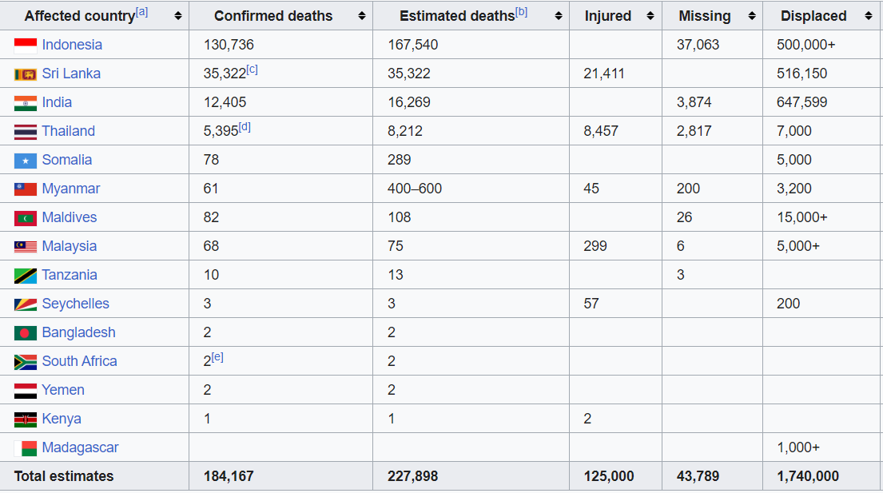
Table of Countries that were directly affected

Slide 9
Environmental Impact
Beyond the heavy toll on human lives, the Indian Ocean earthquake caused an enormous environmental impact that affected the region for many years. Severe damage was inflicted on ecosystems such as mangroves, coral reefs, forests, coastal wetlands, vegetation, sand dunes and rock formations, animal and plant biodiversity and groundwater. Also, the spread of solid and liquid waste and industrial chemicals, water pollution and the destruction of sewage collectors and treatment plants threatened the environment even further, in untold ways. The environmental impact took a long time and significant resources to assess.
The main effect was caused by poisoning of the freshwater supplies and of the soil by saltwater infiltration and a deposit of a salt layer over arable land. In the Maldives, 16 to 17 coral reef atolls that were overcome by sea waves are without fresh water and could be rendered uninhabitable for decades. Uncountable wells that served communities were invaded by sea, sand, and earth; and aquifers were invaded through porous rock. On the island's east coast, the tsunami contaminated wells on which many villagers relied for drinking water.

Slide 10
Economic Impact
While the overall impact on the national economies was minor, local economies were devastated. The two main occupations affected by the tsunami were fishing and tourism.[134] Some economists believe that damage to the affected national economies will be minor because losses in the tourism and fishing industries are a relatively small percentage of the GDP. However, others caution that damage to infrastructure is an overriding factor. In some areas drinking water supplies and farm fields may have been contaminated for years by saltwater from the ocean.
The impact on coastal fishing communities and the people living there, some of the poorest in the region, has been devastating with high losses of income earners as well as boats and fishing gear

Slide 11
Humanitarian Response
Nations all over the world provided over US$14 billion in aid for damaged regions, with the governments of Australia pledging US$819.9 million (including a US$760.6 million aid package for Indonesia), Germany offering US$660 million, Japan offering US$500 million, Canada offering US$343 million, Norway and the Netherlands offering both US$183 million, the United States offering US$35 million initially (increased to US$350 million), and the World Bank offering US$250 million. Also, Italy offered US$95 million, increased later to US$113 million of which US$42 million was donated by the population using the SMS system

Slide 12
EFFORTS
Immediate Response | Rehabilitation and Reconstruction | Community Preparedness
Immediate relief efforts were launched, with neighboring countries and the international community providing aid, medical assistance, and search and rescue operations. | Long-term recovery plans were implemented, focusing on rebuilding infrastructure, providing housing, and restoring livelihoods for the affected communities. | Efforts were made to strengthen early warning systems, educate communities about tsunamis, and establish disaster preparedness measures to mitigate future impacts.

Slide 13
Preventive Measures
Improved Early Warning Systems
Enhanced tsunami monitoring and early warning systems were implemented to provide timely alerts to coastal communities.
Evacuation Routes and Shelters
Efforts were made to establish clear evacuation routes and safe shelters to ensure the quick and safe evacuation of residents.
Tsunami-Resilient Infrastructure
Building codes and construction practices were revised to incorporate tsunami-resilient features in coastal infrastructure.

Slide 14
Conclusion and Key Takeaways
Importance of Preparedness
Disaster preparedness is crucial in minimizing the impact of tsunamis and saving lives.
The IFRC supports National Societies to continually improve their local preparedness and response capacity—ultimately preventing and reducing the impacts of disasters on communities.
Nature's Power
The Indian Ocean Tsunami serves as a reminder of the immense power and unpredictability of natural disasters.

Slide 15
Thanks for being till end

